Slide 1


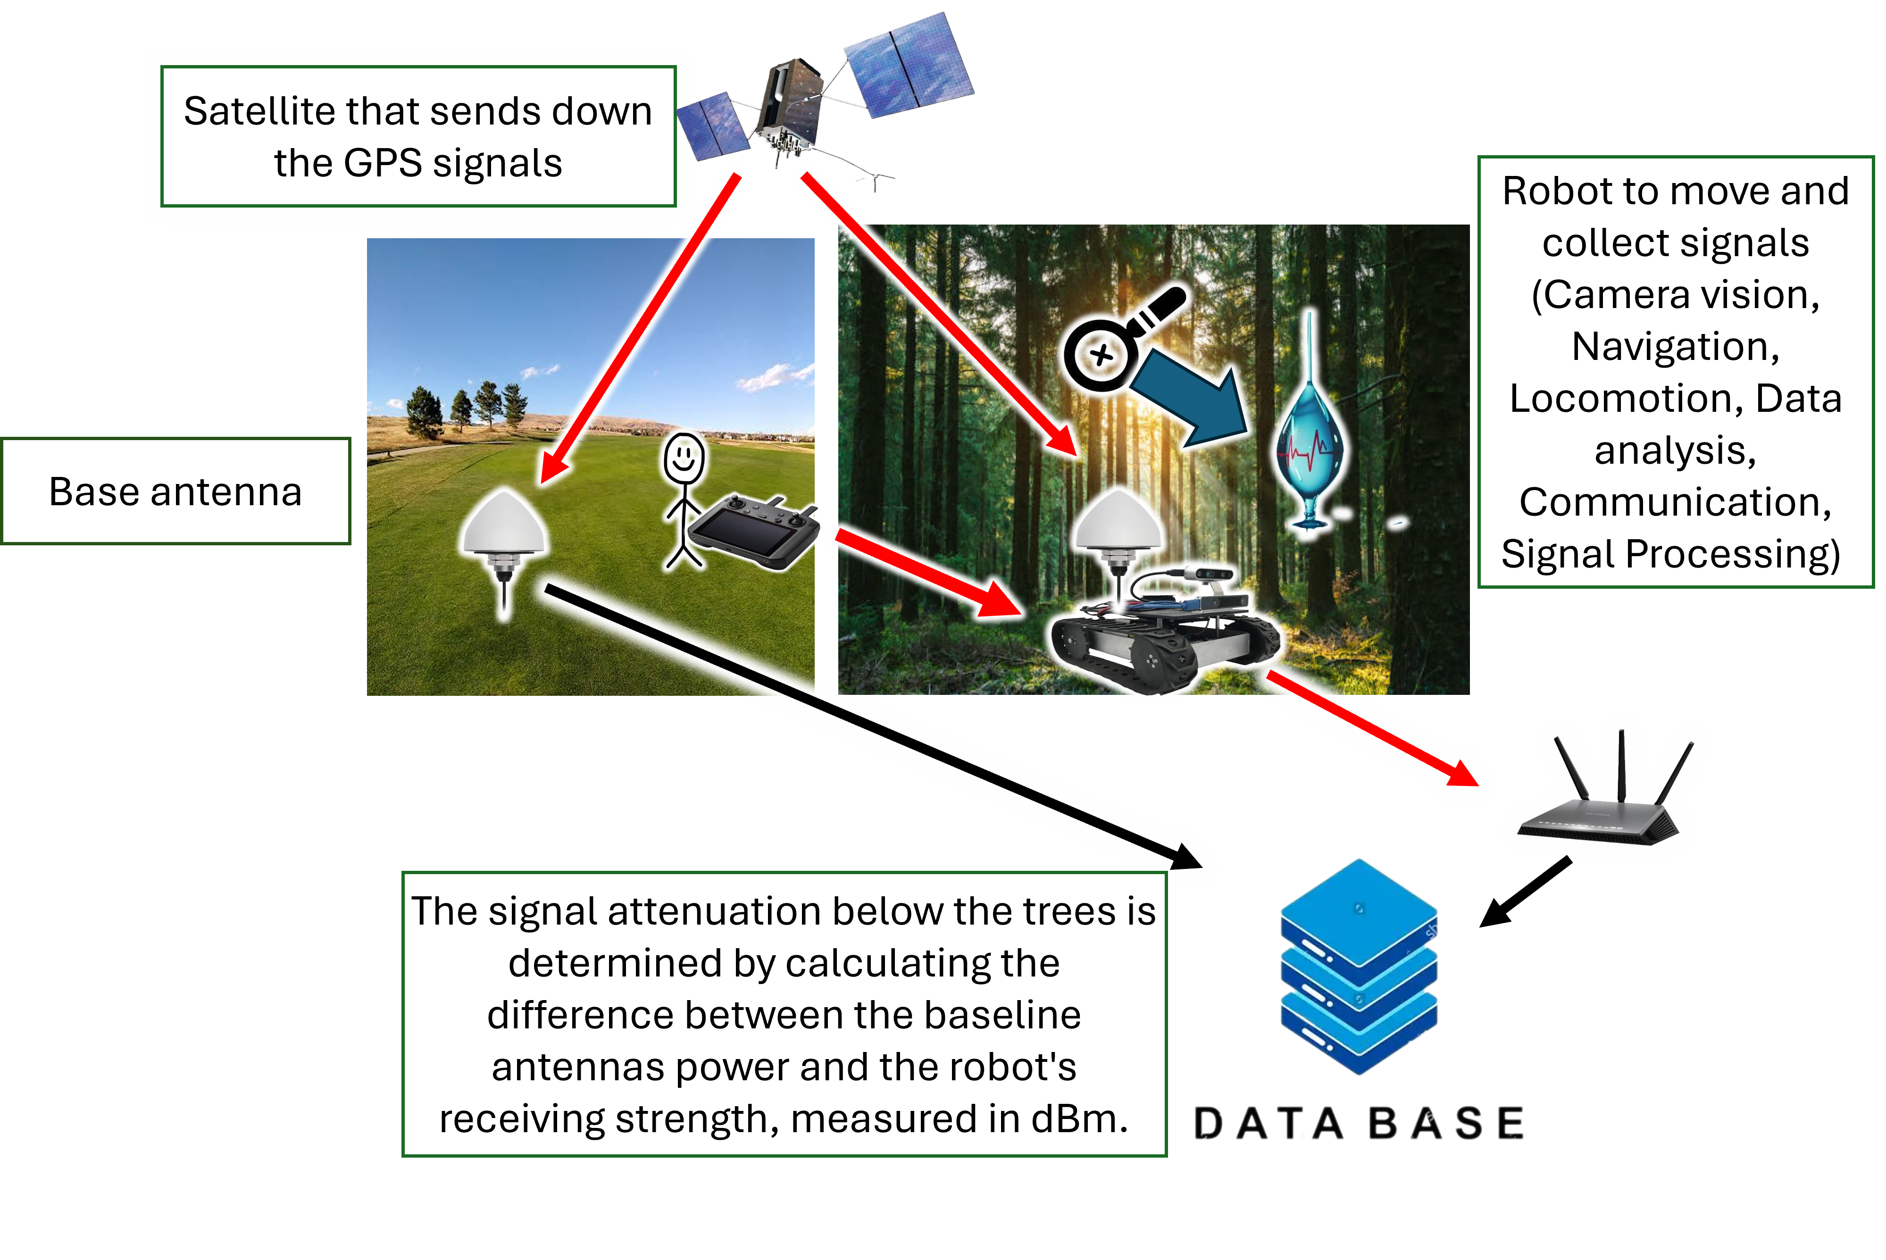
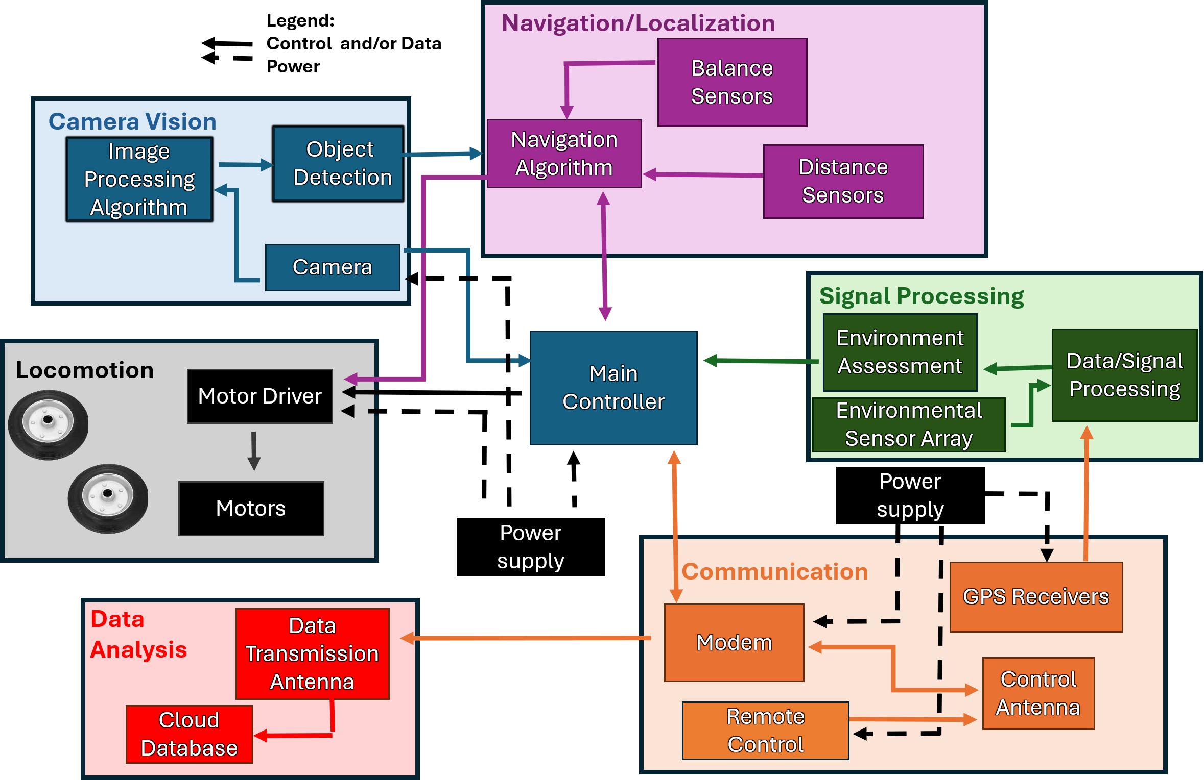
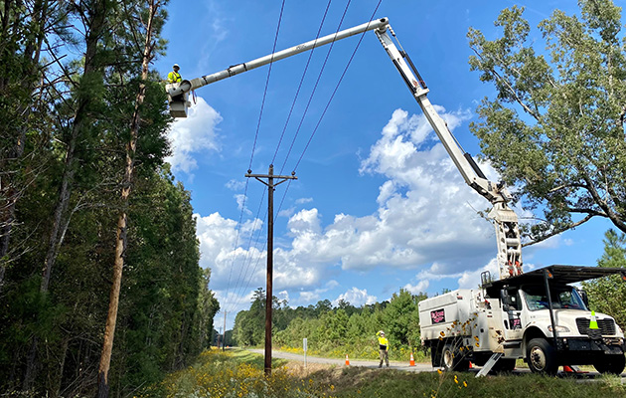
Forest Buddy
John Allen (Project Manager), Joshua McGee (Chief Scientist),
Landon Garrett (CPE), Gerardo Hernandez (EE), Alten Reeves (EE), Lane Williams (EE)
Department of Electrical and Computer Engineering
Mississippi State University
Problem and Target User
Solution
Broader Impact
Official MSU Colors
  Nearly 11% of forests in the US are exposed to drought, expected to rise to 38% by mid-century [1].
  11-16% of tree species are threatened by extinction due to pests and diseases [2]
Benefits for target user
Cuts labor and time costs of inspecting large quantities of trees.
Nondestructive; requires no trees to be harmed.
Catches drought and disease early.
Potential impacts in other fields
Forest Buddy could help the power industry by detecting at-risk trees near powerlines.
It could help with fighting wildfires as canopy moisture data could be used for regional fire risk models.
Unlikely Byproducts
The sensors could be changed to monitor other environmental characteristics.
Previous Solutions
Leaf Link
  Used a pulley system.
  Extremely limited mobility.
Manual Inspection
  Economical, but impractical for inspecting large areas, and often too late to detect diseases [3], [4].
Lab Testing
  Fast and effective, but requires the tree to be cut, which harms the tree [3],[4].
System Diagram
0.5” Square that can be
used for measuring
margins and spacing
References
Competitive Advantages
[1] “Forests and a future of drought: Area exposed to severe drought projected to triple by 2070 | US Forest Service Research and Development,” US Forest Service Research and Development, 2026. https://research.fs.usda.gov/srs/articles/forests-and-future-drought-area-exposed-severe-drought-projected-triple-2070 (accessed Sept. 03, 2026).
[2] “Researchers complete first comprehensive threat assessment of all U.S. trees,” United States Botanic Garden, Aug. 23, 2022. https://www.usbg.gov/blog/researchers-complete-first-comprehensive-threat-assessment-all-us-trees (accessed Sept. 08, 2026).
[3] M. Li, H. Li, X. Ding, L. Wang, X. Wang, and F. Chen, "The detection of pine wilt disease: A literature review," Int. J. Mol. Sci., vol. 23, no. 18, p. 10797, Sep. 2022, doi: 10.3390/ijms231810797.
[4] S. Tahir, S. S. Hassan, L. Yang, M. Ma, and C. Li, "Detection methods for pine wilt disease: A comprehensive review," Plants, vol. 13, no. 20, p. 2876, Oct. 2024, doi: 10.3390/plants13202876.
Catches disease earlier than manual methods.
More time efficient.
Inexpensive.
  ≤ $1000
Data collection is non-destructive.
Scalable.

